Slide 1
CSE 471: MACHINE LEARNING
Deep Learning

Slide 2
Outline
Feedforward neural network
  Multi layer perceptron (MLP)
Convolutional neural network
Recurrent neural network

Slide 3
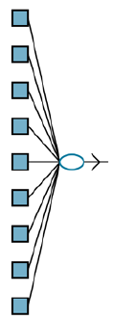
Perceptron

Slide 4
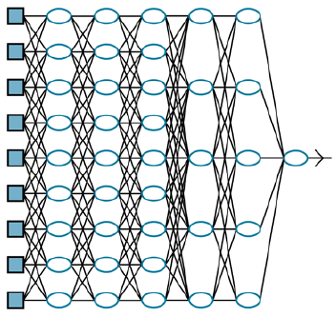
Multi layer perceptron
Deep learning network
A deep learning network has longer computation paths, allowing each variable to interact with all the others.
Notes:
Discuss:
Hidden layer
Fully connected network

Slide 5



Feedforward Network
g_{j} – Nonlinear activation function
There is an intercept b. Think of it as weight given to a fixed +1 activation node.
Nonlinearity (Sigmoid)

Slide 6

Nonlinearity
Sigmoid
ReLU(x) = max(0, x)
softplus(x) = log(1 + e^{x})
Notes:
Explain the need for non-linearity
The nonlinearity is what allows sufficiently large networks of units to represent arbitrary functions.
ReLU - Rectified linear unit
The softplus function, a smooth version of the ReLU function
The derivative of the softplus function is the sigmoid function.
Why?
The universal approximation theorem states that a network with just two layers of computational units, the first nonlinear and the second linear, can approximate any continuous function to an arbitrary degree of accuracy.

Slide 7
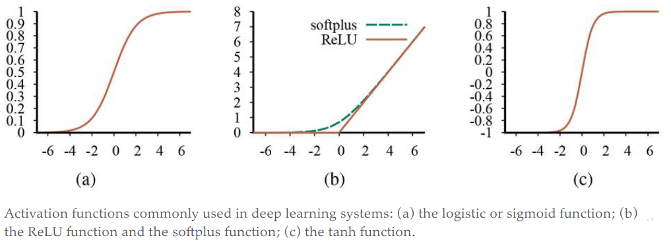
Nonlinearity
Notes:
Notice that all of them are monotonically non-decreasing,
Therefore, their derivatives are nonnegative

Slide 8
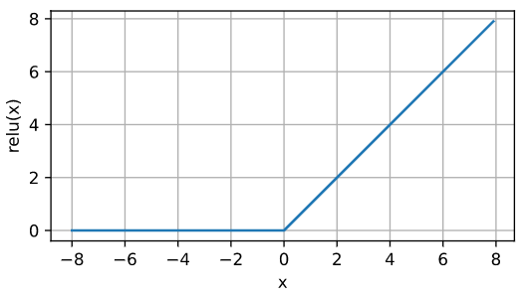
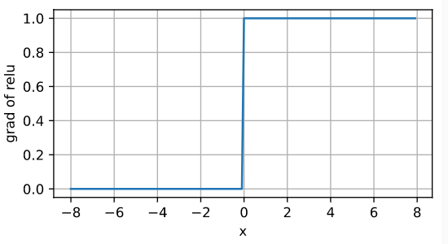
ReLU

Slide 9
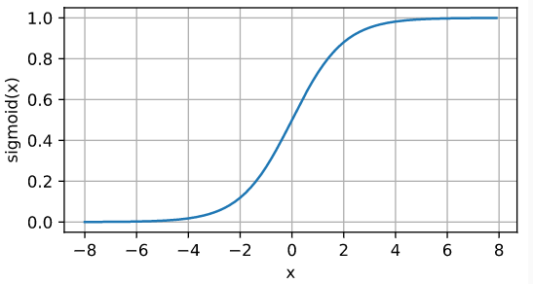
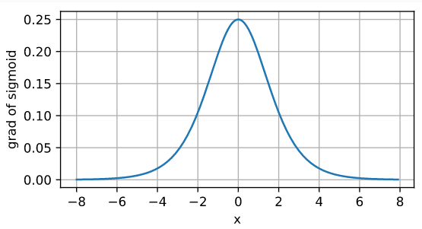
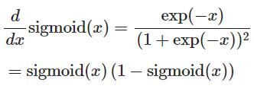
Sigmoid

Slide 10
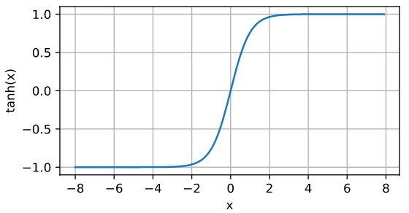

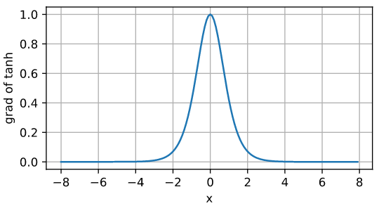

Tanh

Slide 11
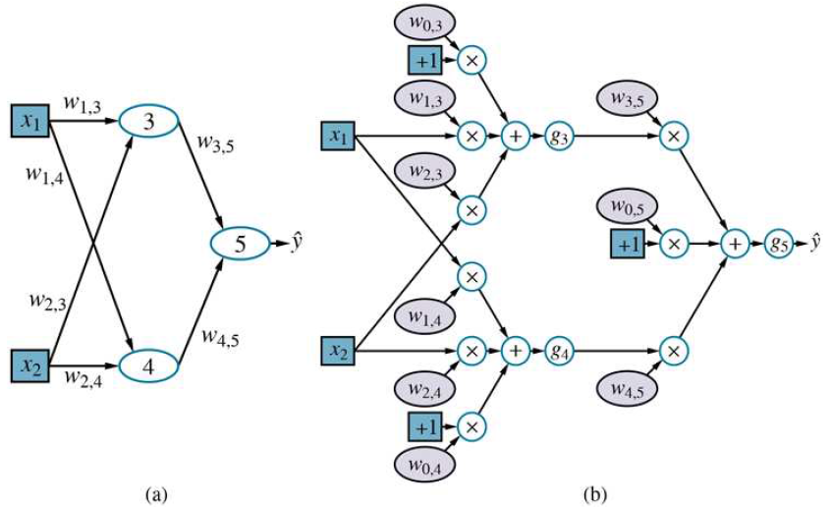
Computation Graph
Notes:
(a) A neural network with two inputs, one hidden layer of two units, and one output unit. Not shown are the dummy inputs and their associated weights.
(b) The network in (a) unpacked into its full computation graph.

Slide 12
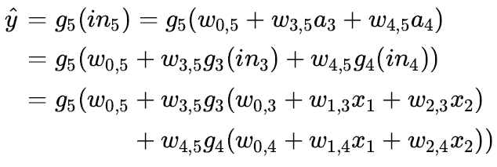
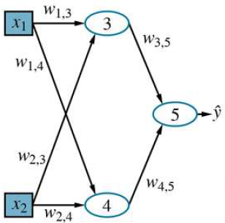

Forward computation
Notes:
W – weight matrix
W^{(i)} – weights in the i-th layer
g^{(i)} – Activation functions in the first and second layers. Then the entire network can be written as

Slide 13
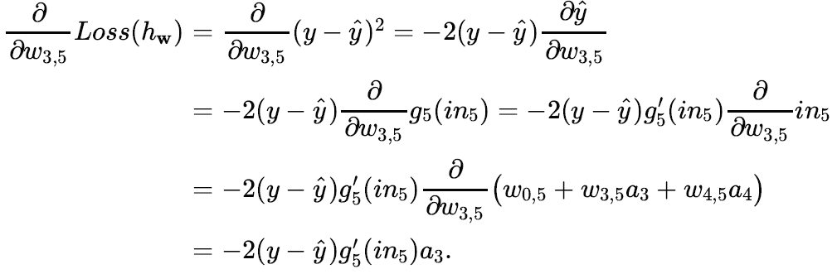
Gradients

Slide 14

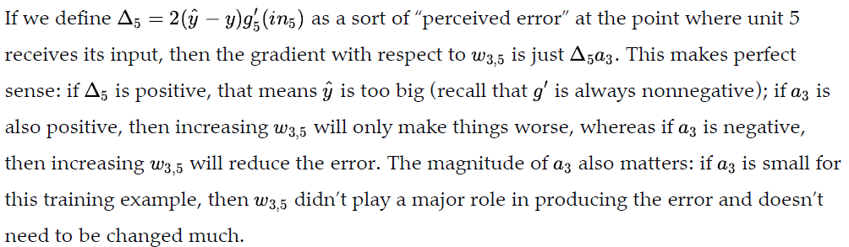
Gradients

Slide 15
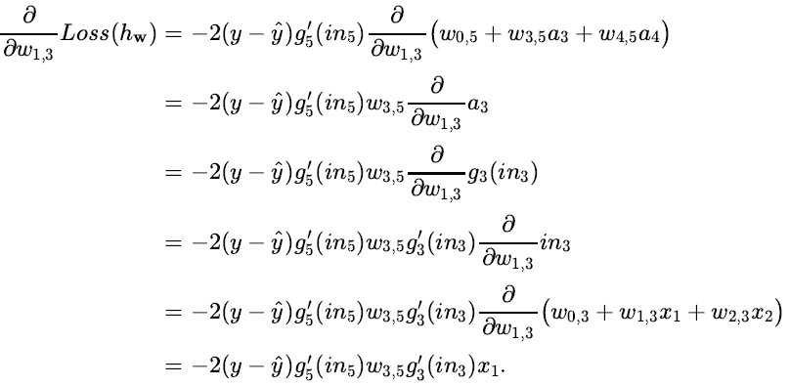
Gradients

Slide 16

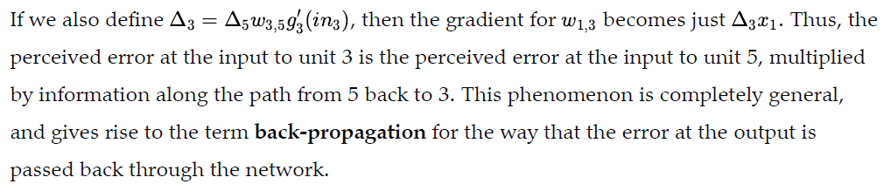
Gradients

Slide 17
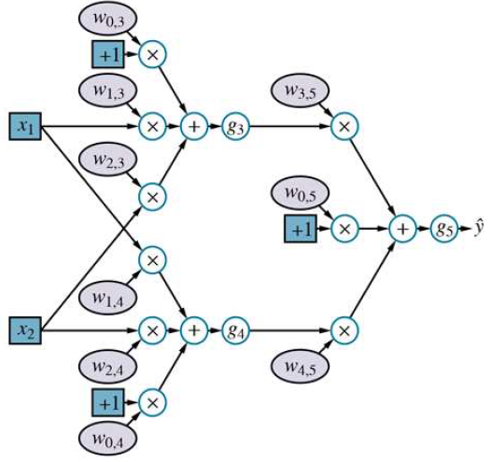
Home work
w_{0,3} = 1, w_{0,4} = -1, w_{0,5} = 1
w_{1,3} = 2, w_{1,4} = 4, w_{2,3} = 3
w_{2,4} = 1, w_{3,5} = 2, w_{4,5} = 3
x₁ = 5, x₂ = -3
y = 1
Non-linearity = Sigmoid
y_hat = ?
Calculate the gradients
  w.r.t the w’s.

Slide 18


Cross-entropy loss
Loss for single data point
Loss for n data point
Notes:
We want to maximize the likelihood of

Slide 19
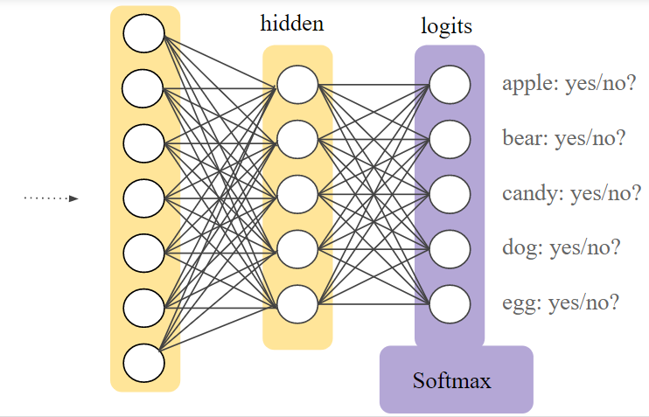
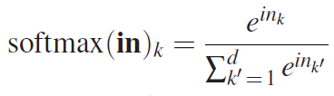
Soft-max
Notes:
Because of the exponentials, the softmax layer makes the differences in the inputs more prominent
Smooth, differentiable

Slide 20
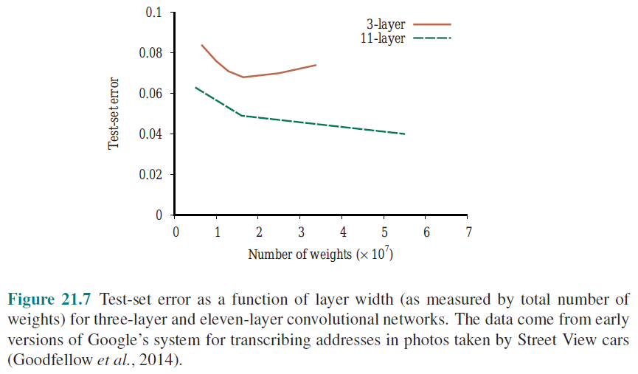
Shallow vs. Deep network’s Performance

Slide 21
Gradients
Vanishing gradient
  Derivatives can be very close to 0
  Changing the weights may have negligible effects.
Automatic differentiation
  Systematic application of chain rule.

Slide 22
Issue of ReLU not being differentiable at x = 0
https://www.mldawn.com/relu-activation-function/

